Slide 1

Text Feature Highlighter
Students: Shiran saada & oren Toledano
Supervisors: Dror Epstein & Dimitry Giber

Slide 2
Introduction
Every text description has many features included in it.
Sometimes a feature is lost in the big story because there are many features and the description of each feature is spread across the entire story, this is where "Feature Highlighter" comes in place.
In order to complete such a complicated task, a software project will be developed to find the descriptive sections related to features in the entire text.

Slide 3
Our Objective
This project involves technologies such as NLP and Machine learning as a part of a bigger project, the relevant sections representing a feature should be highlighted for clarity and displayed to the user which may assign a different feature to highlighted section in the same user interface.
The application will be integrated in the company-wide text searching engine that will greatly reduce costs of writing, analyzing and maintaining documentation.

Slide 4
Methodology
Agile development methodology
Weekly progress discussions
Constant consultation by need

Slide 5
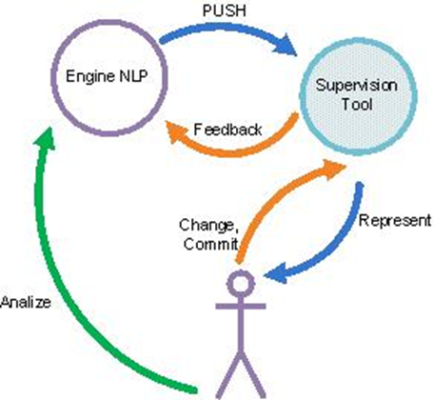
Project Process Diagram

Slide 6
Milestones
Analyze & Design (Week 4) Fully understanding the system workflow and the interaction with the environment (input and output formats). Designing the program down to the class level.
Coding (Week 7) Writing the code, debugging and minor testing. Emphasis will be placed on portability and proper documentation.
Testing & Finalizing (Week 12) Testing the program, fixing any bugs found.
End of delivery (Week 13) Deliver the final products.

Slide 7
Development Environment
The program will be written in Python using PyCharm community edition.
Use of open source code.

Slide 8
Significant Risks
There are no special risks or obstacles identified.

Slide 9
Deliverables
The final version of the project will be able to receive an input from the NLP system and will be able return an output file.
GUI of source code software
Installation guide
User guide

